Slide 2
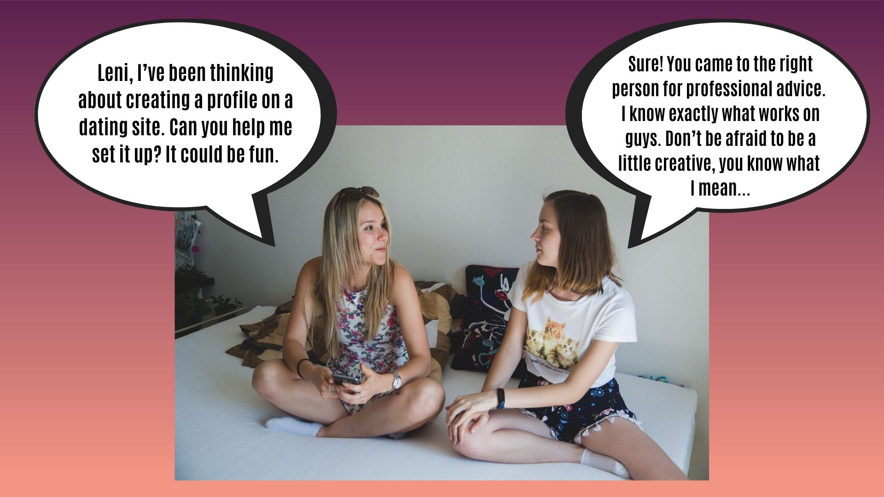

Slide 5
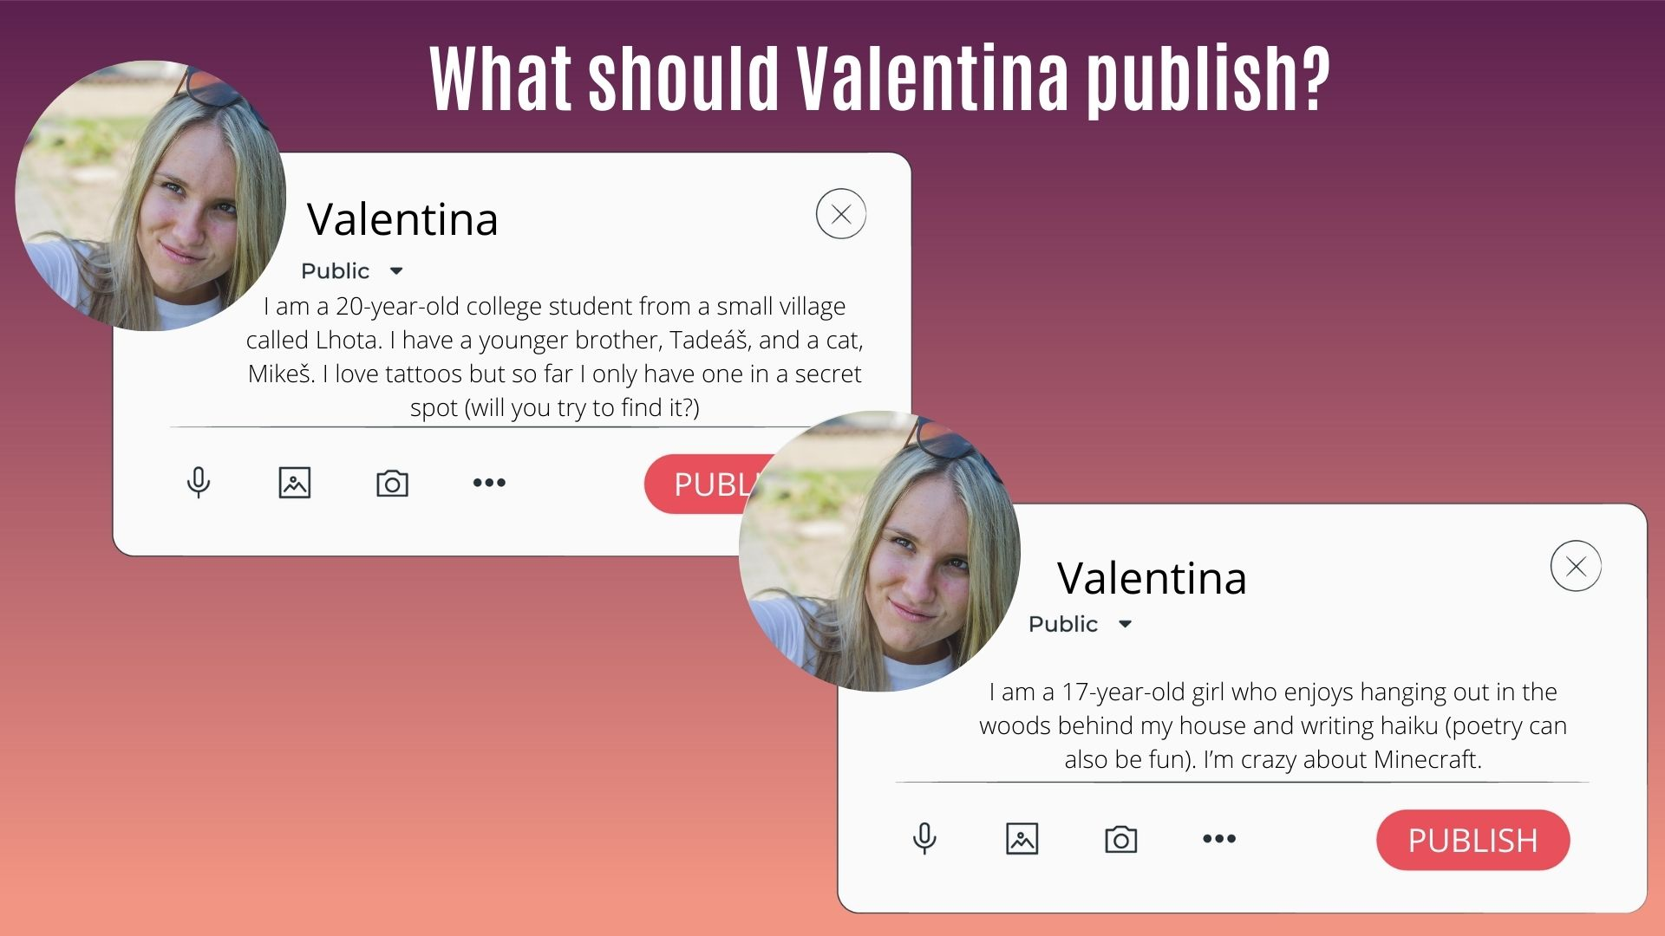
A) Profile with lots of personal information, such as location information, and a few fake things.
B) True profile, where ther is not so much personel data.

Slide 8
A) She sends a photo wearing a bra.
B) She trolls him and sends a photo of her leg.

Slide 10
She ignores him.
She reports his profile.

Slide 12
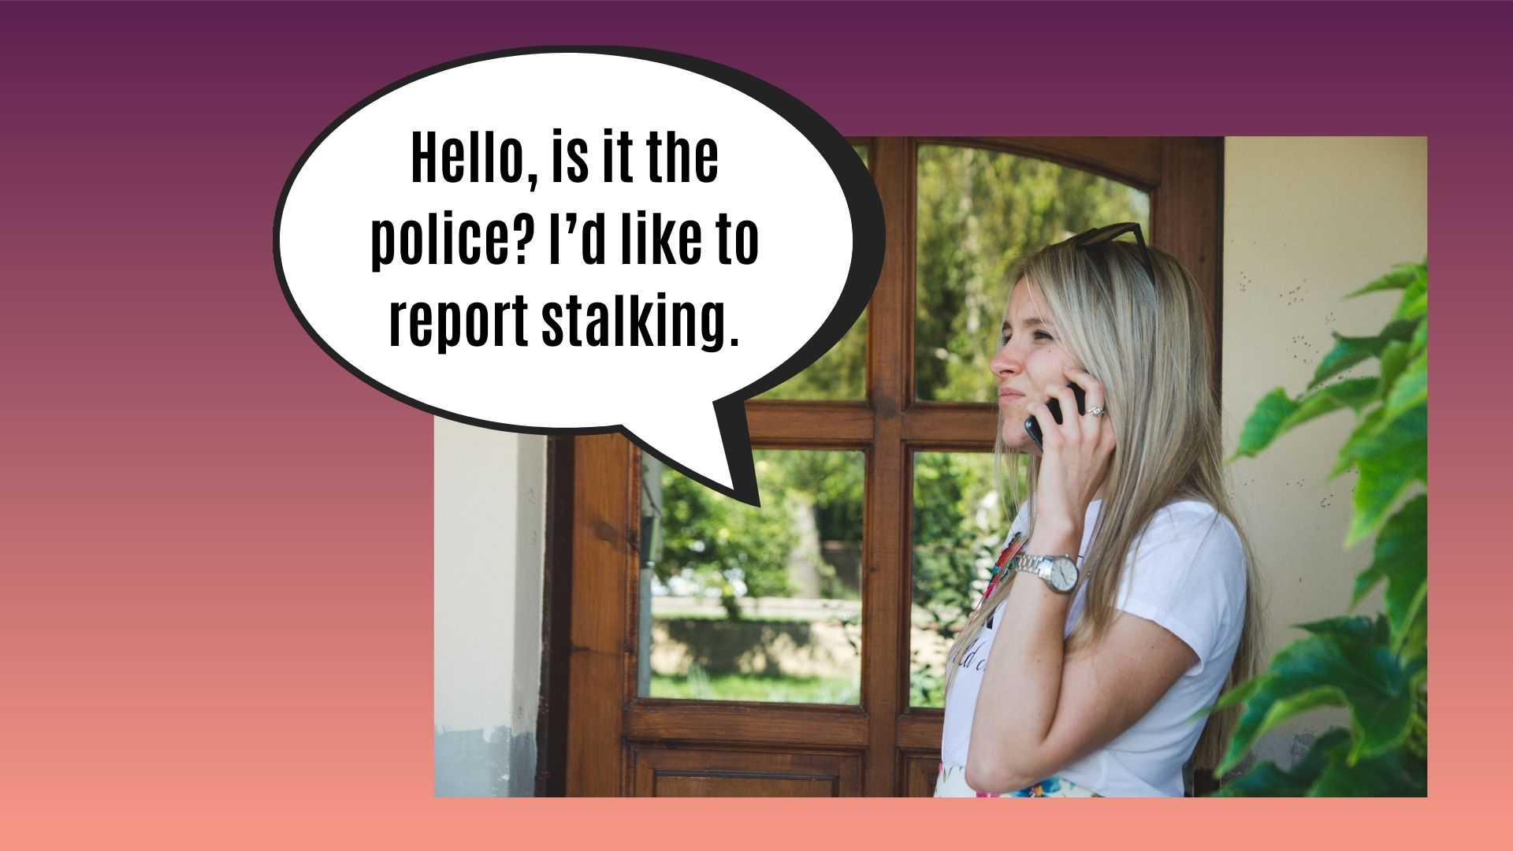

Slide 14
MENWHILE, IN A TOWNN NEARBY...

Slide 16
MEANWHILE, IN A TOWN NEARBY...

Slide 19
She ignores him.
She reports his profile.

Slide 21
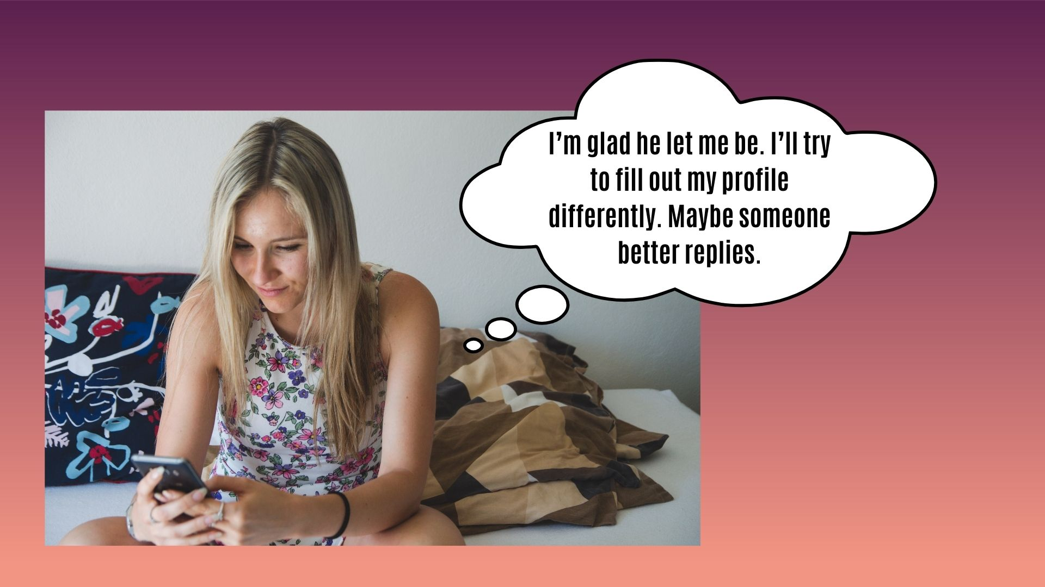

Slide 22
MEANWHILE, IN A TOWN NEARBY...

Slide 25
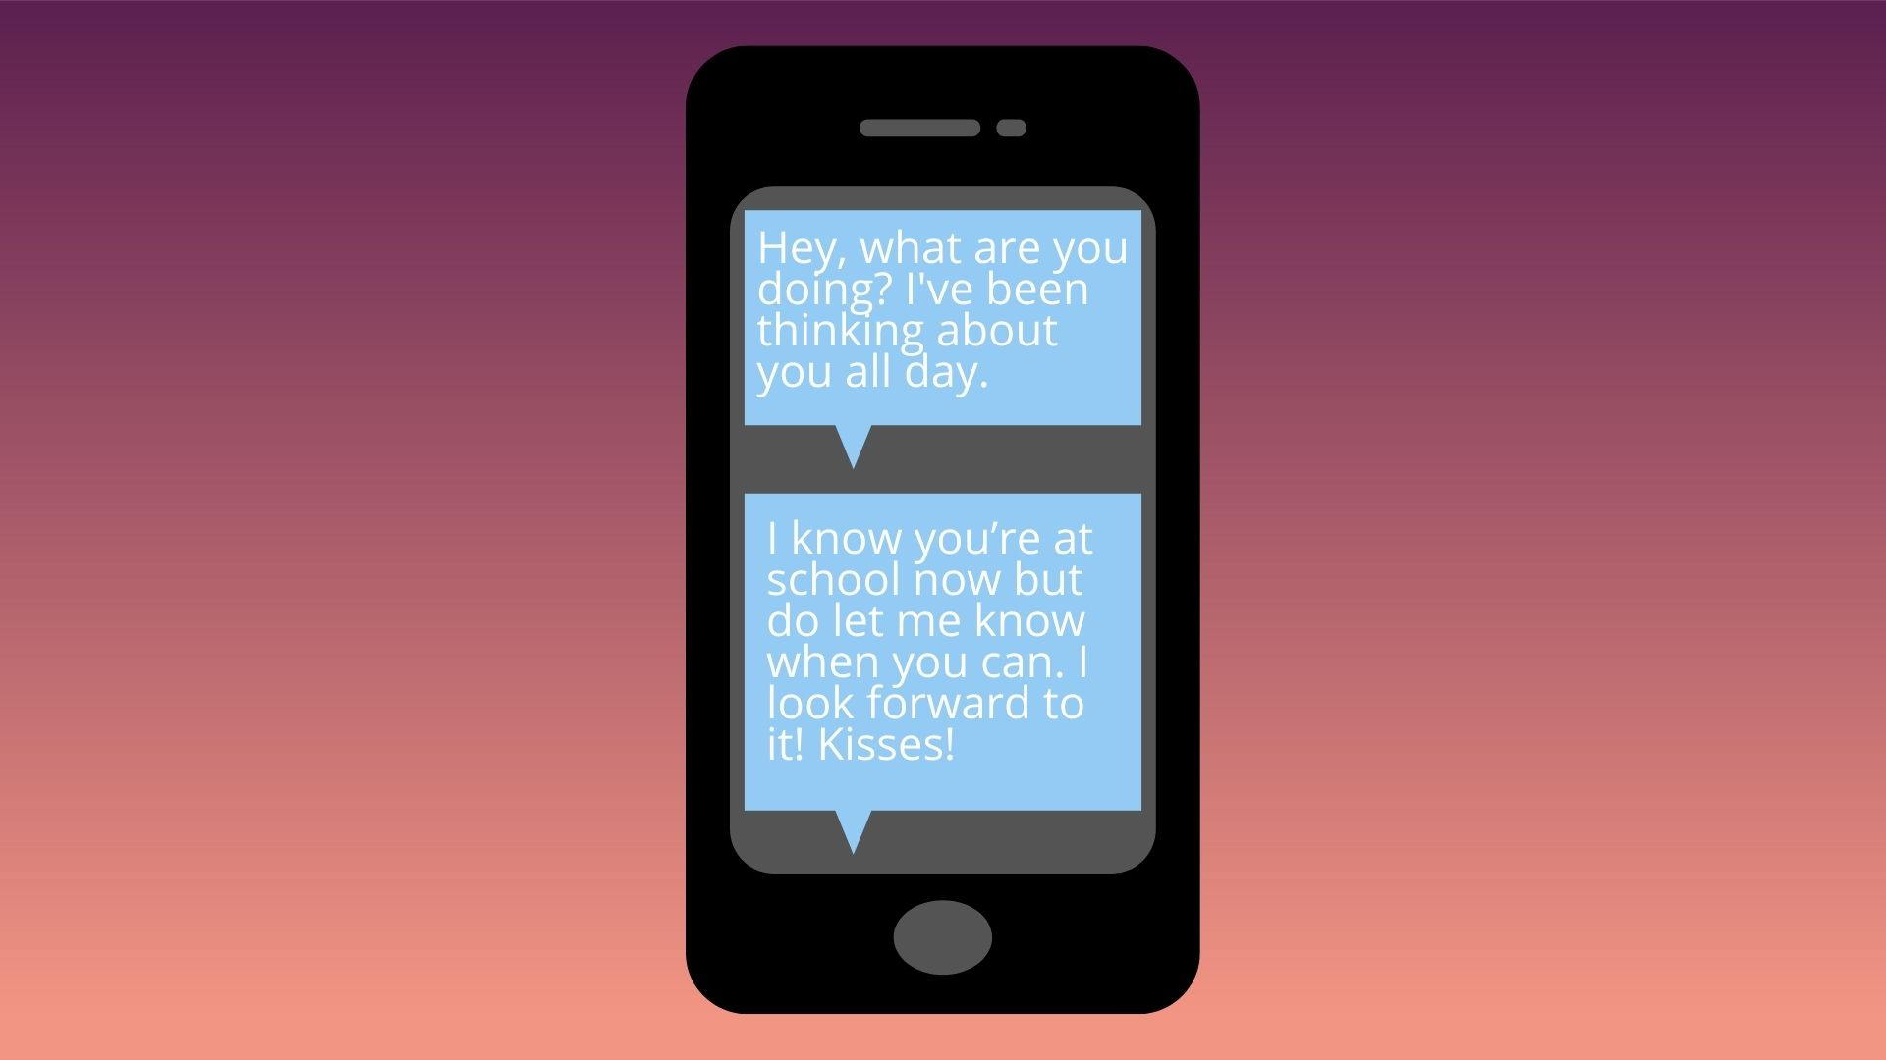

Slide 27
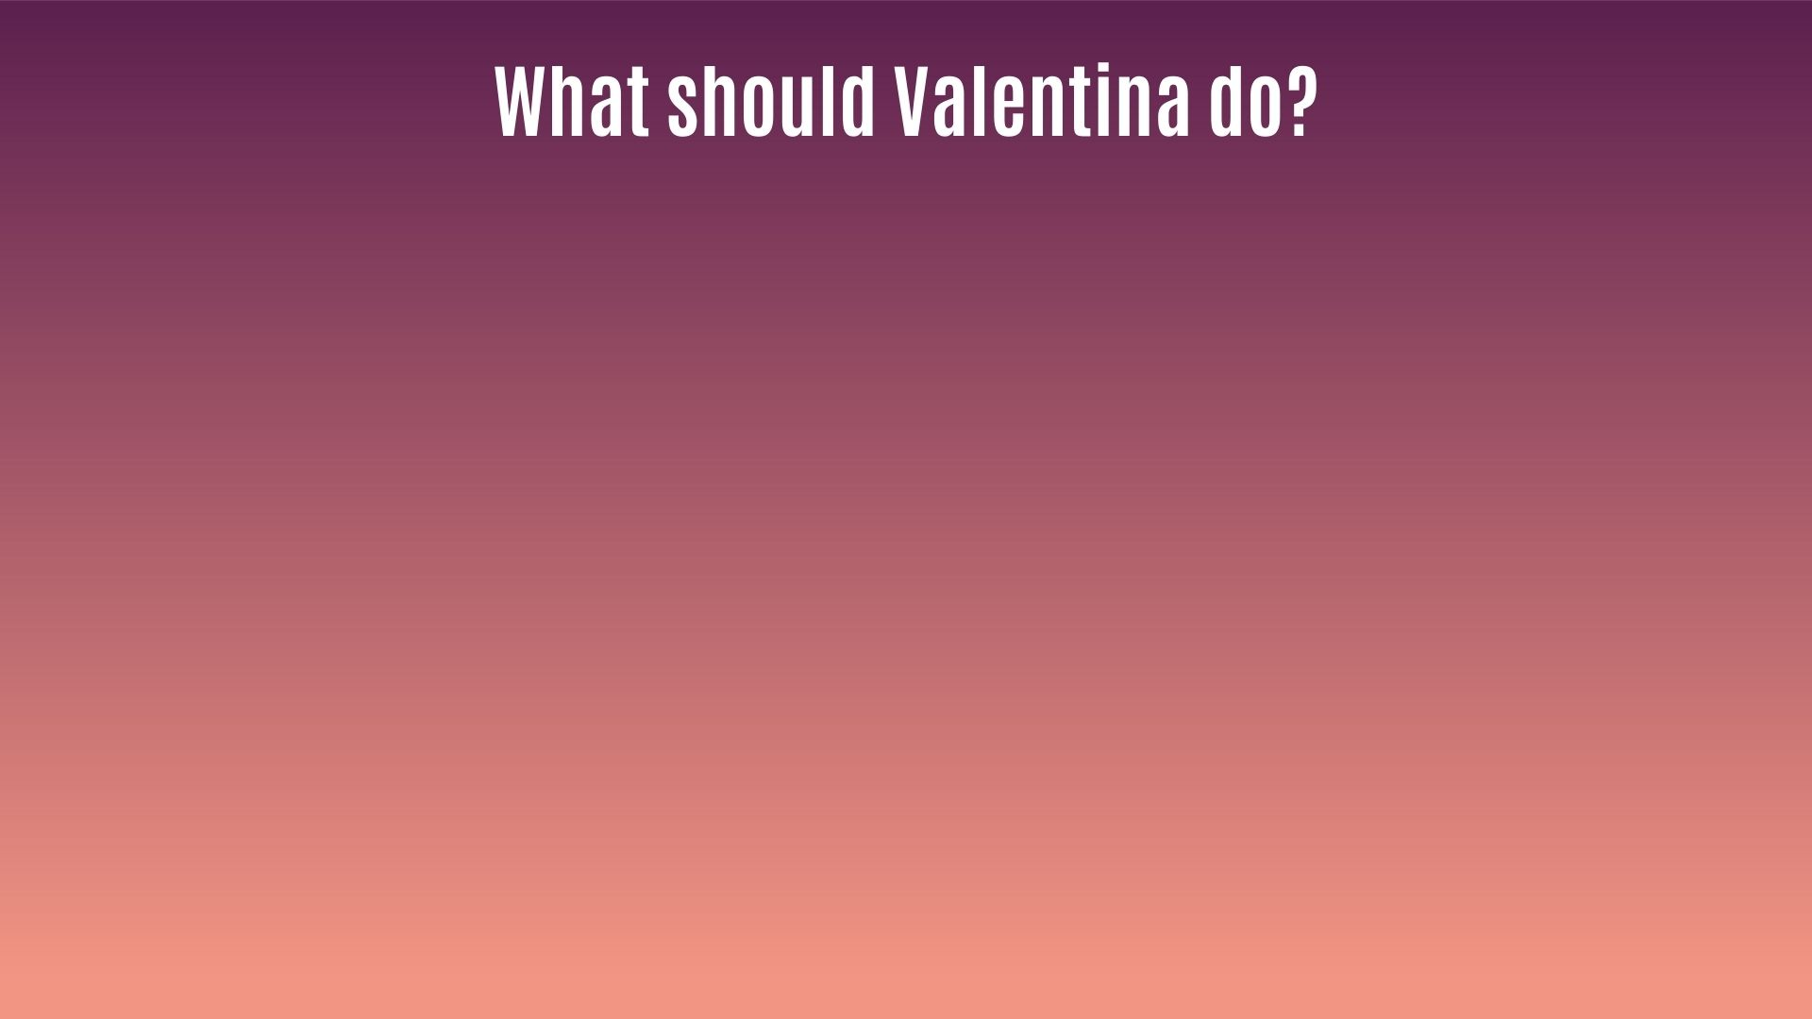
She tells him sincerely that she doesn’t like his style of communication. She suggests staying friends
She ignores him.

Slide 28
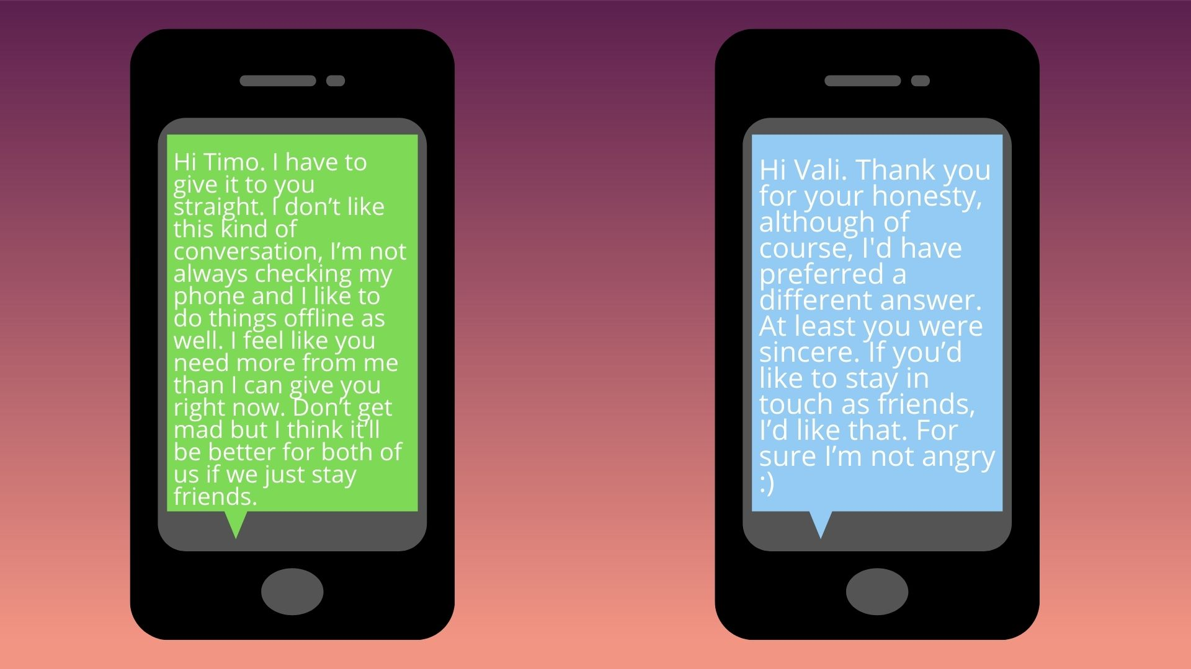

Slide 29
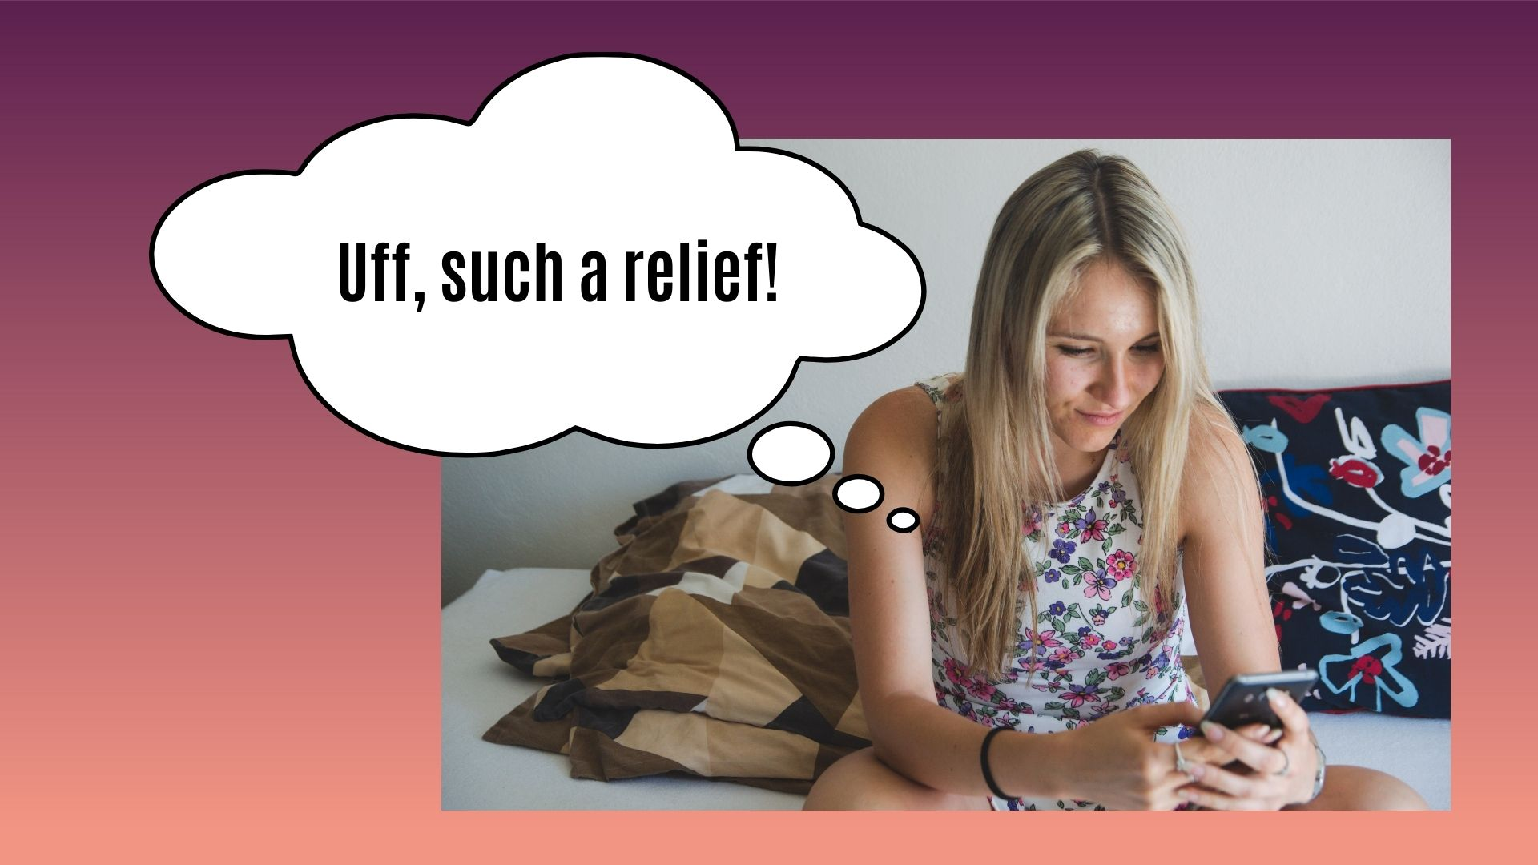

Slide 31
MEANWHILE, IN A TOWN NEARBY...

Slide 32
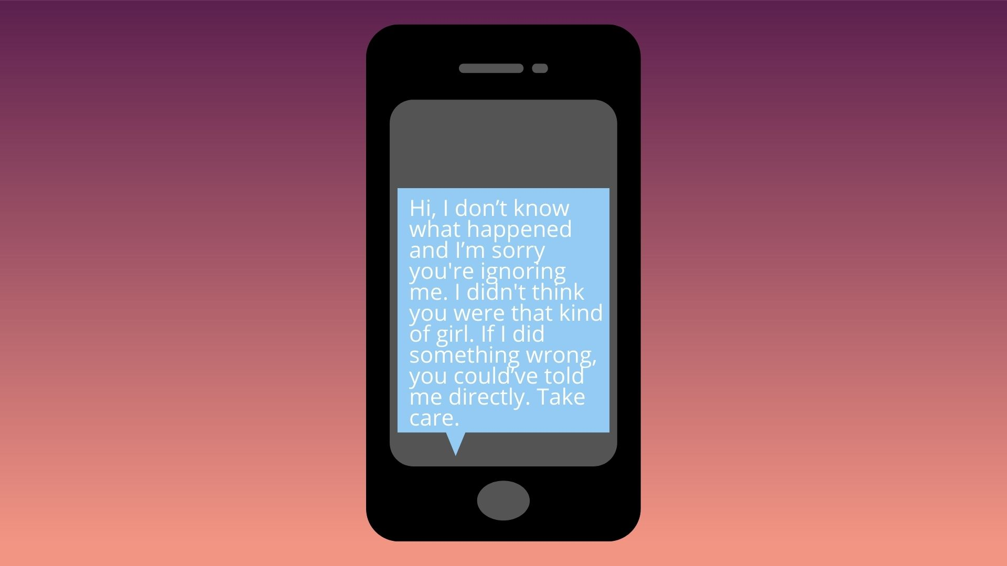

Slide 33
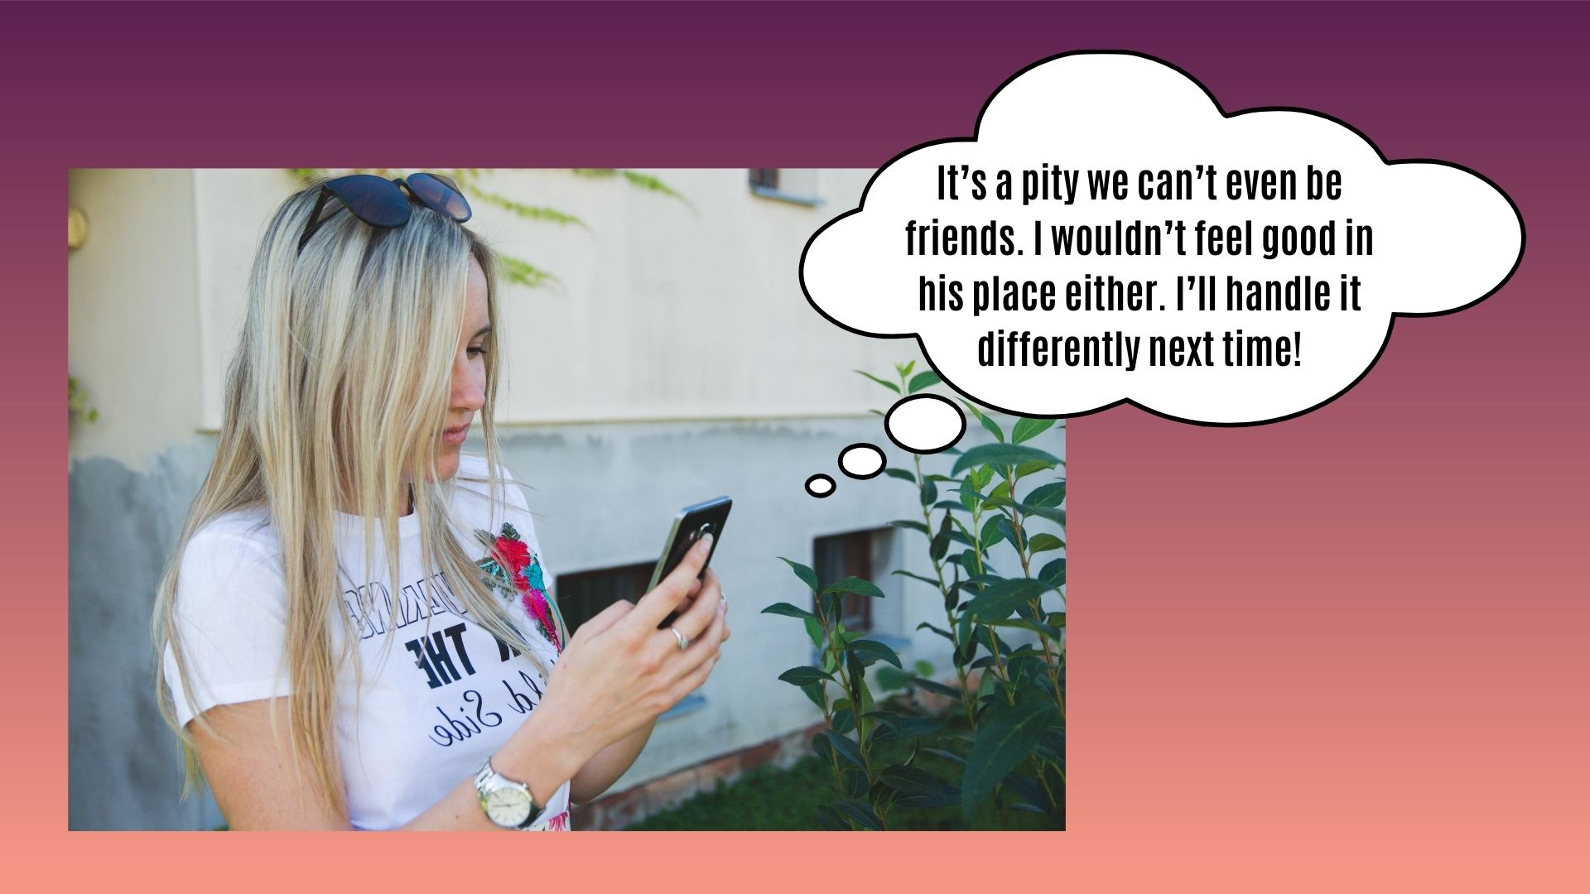

Slide 34
MEANWHILE, IN A TOWN NEARBY...

Slide 40
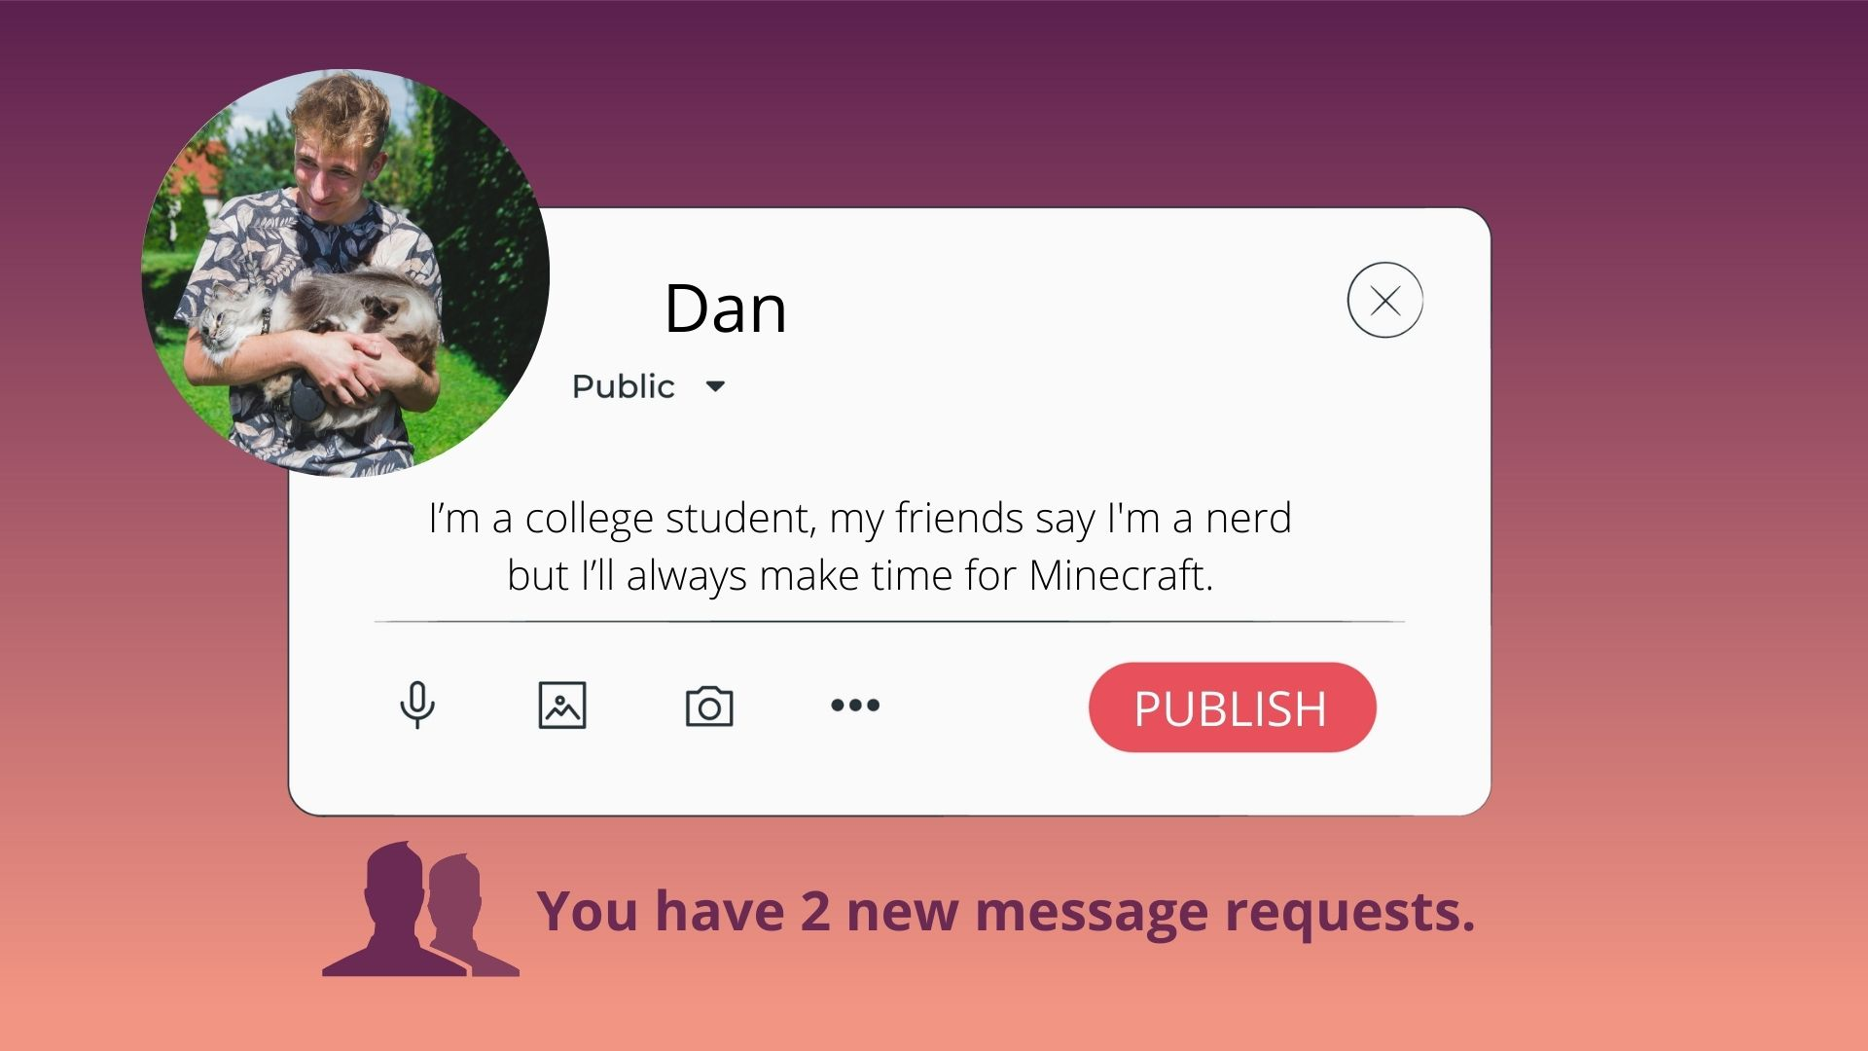

Slide 41
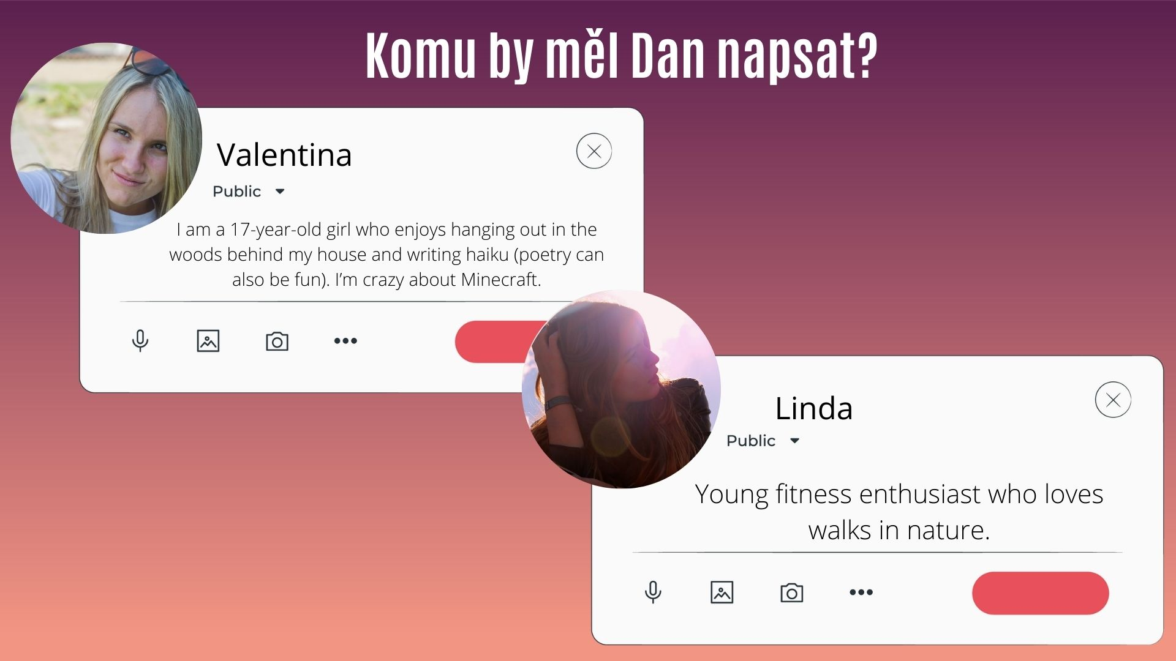
A) Linda
B) Valentina

Slide 43
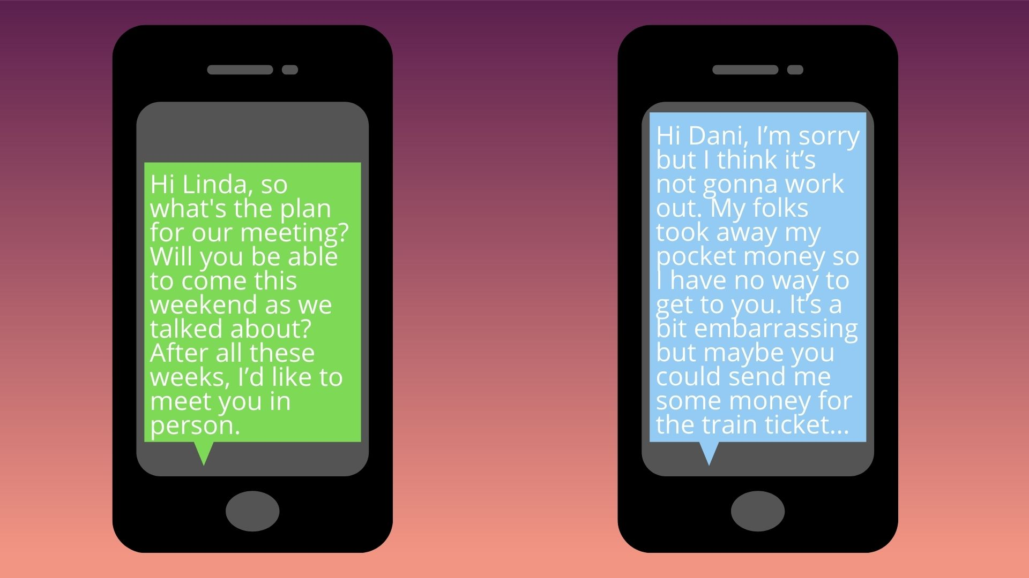

Slide 44
YES
NO

Slide 45
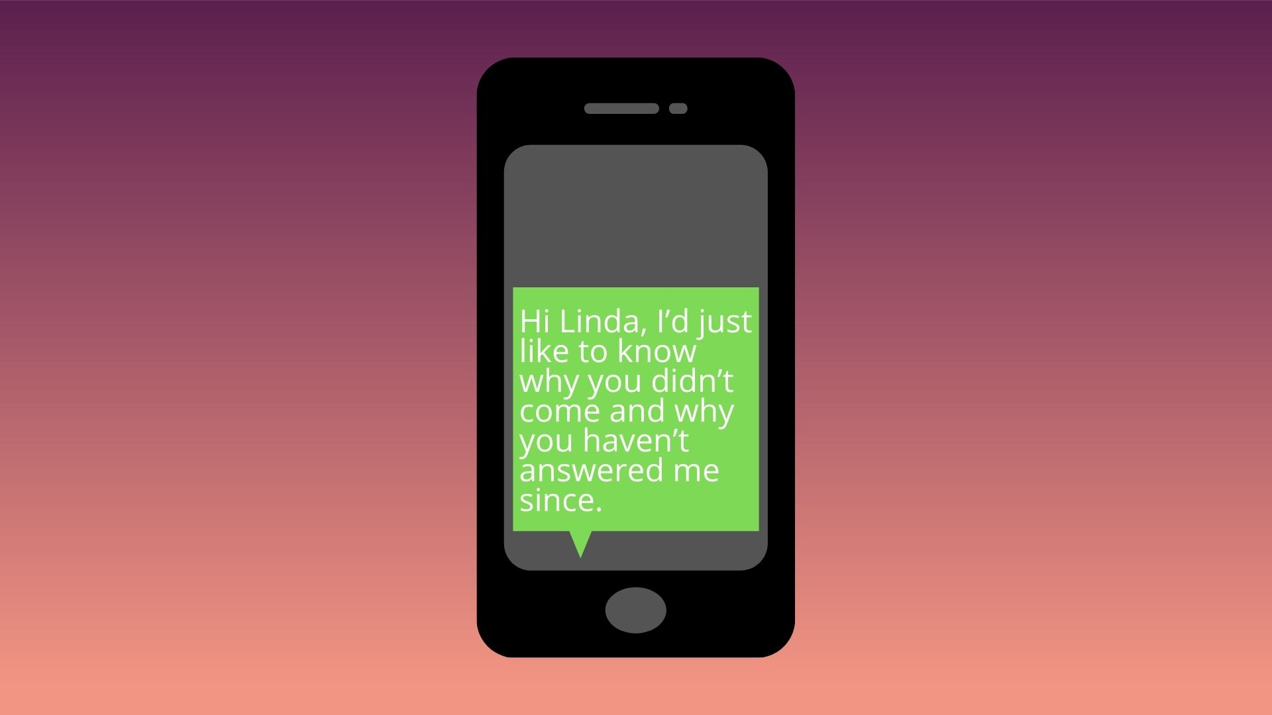

Slide 47
A FEW WEEKS LATER

Slide 48
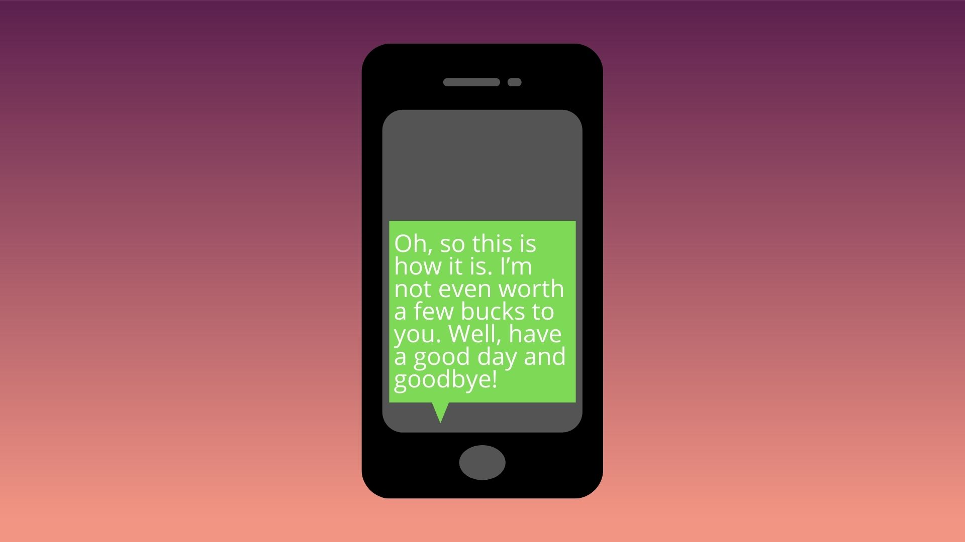

Slide 59
Yes
No

Slide 61
Yes
No

Slide 63
Yes
No

Slide 65
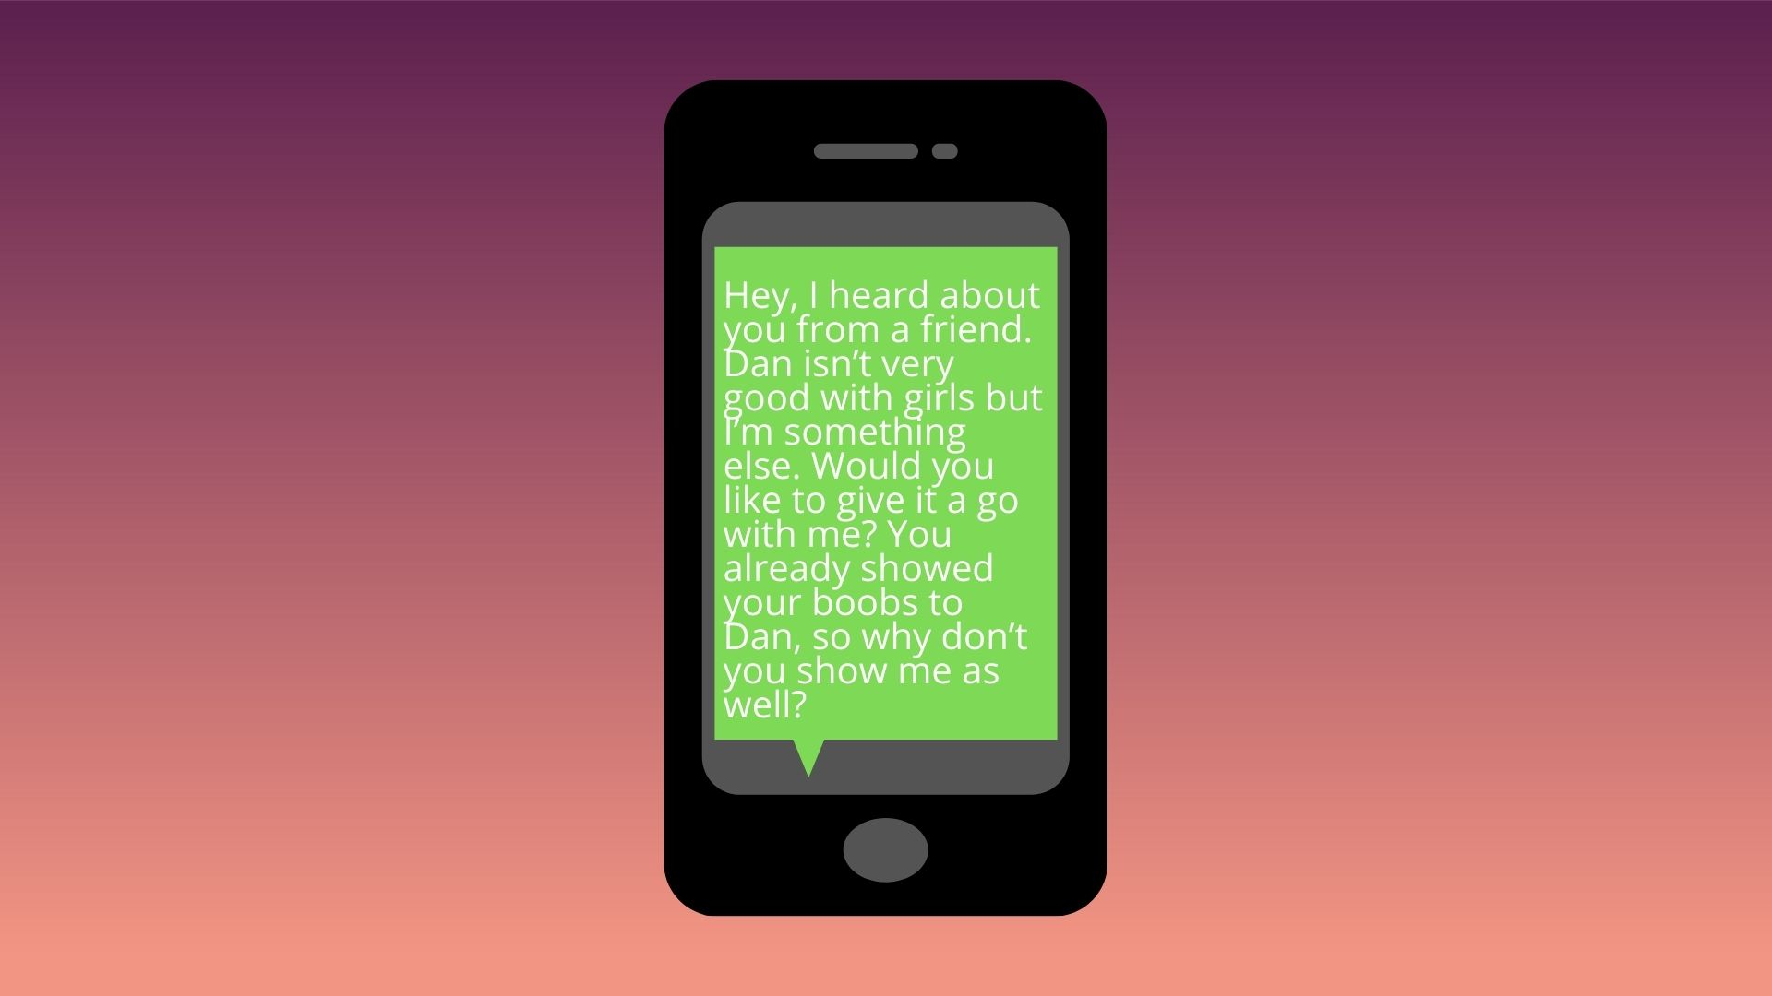

Slide 67
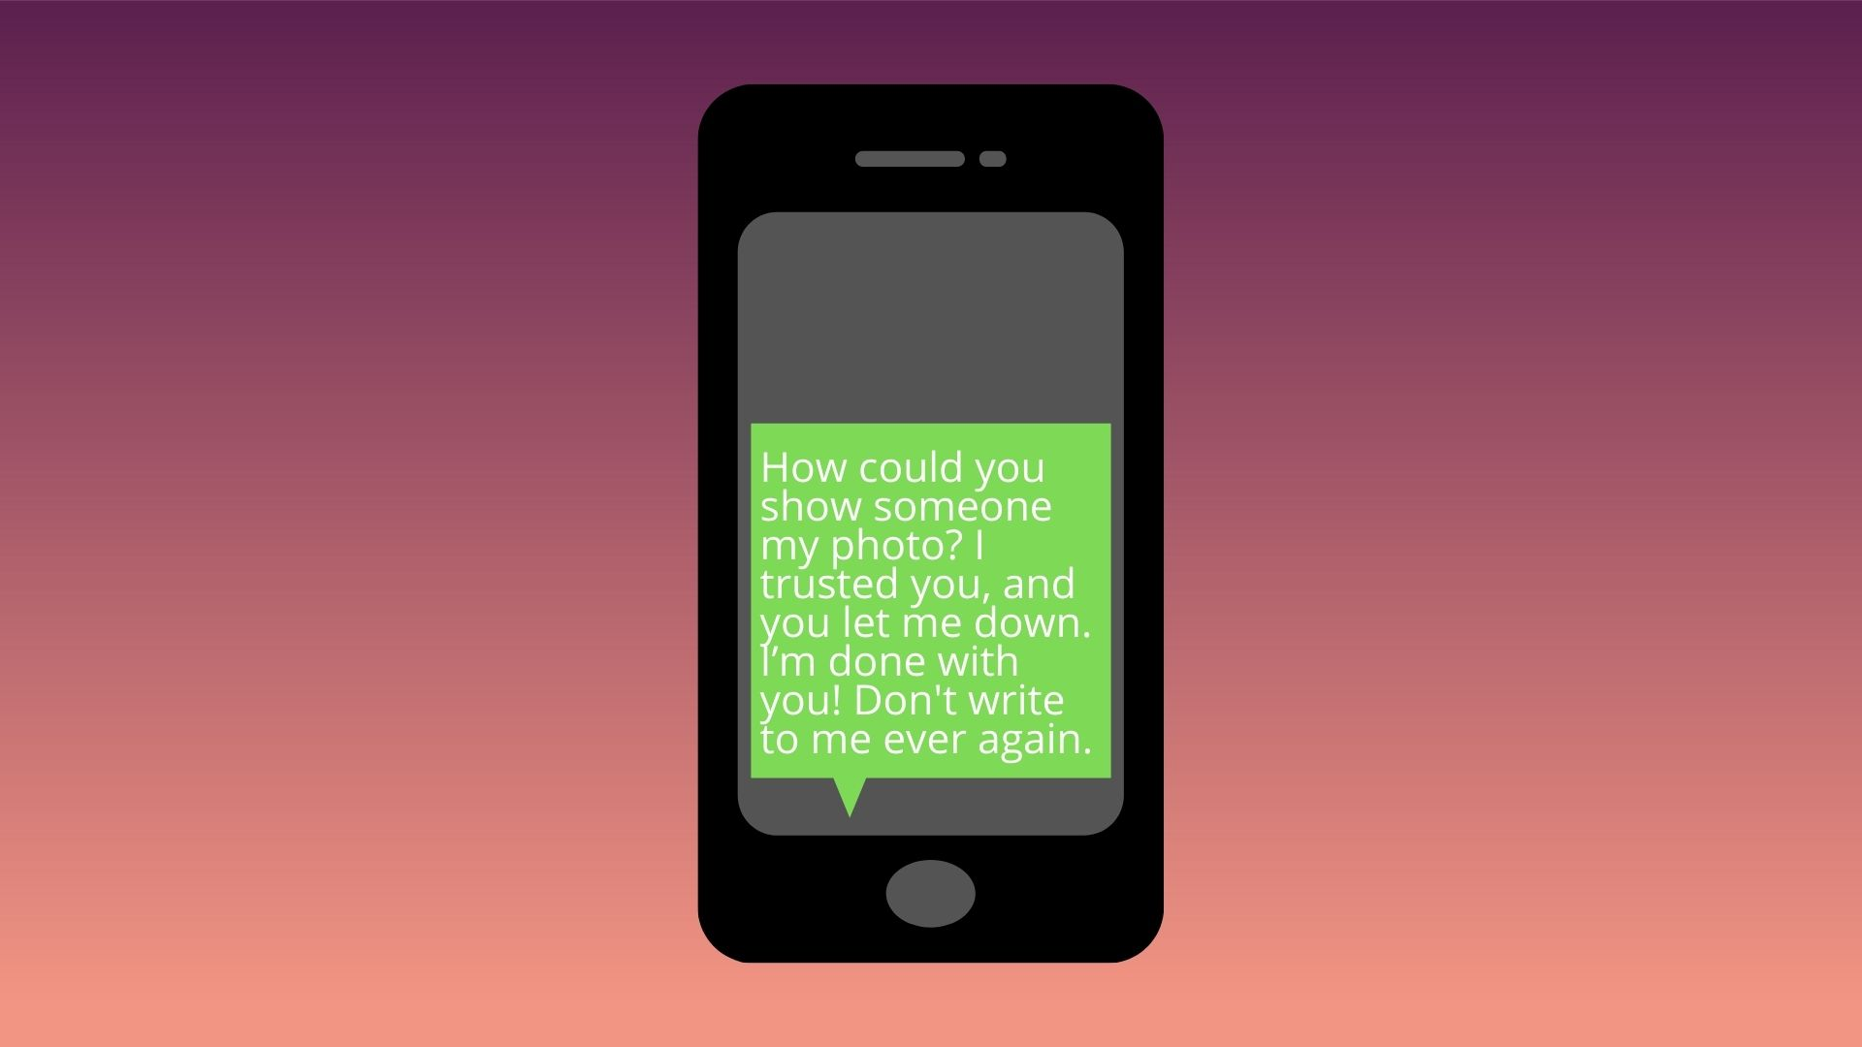

Slide 72
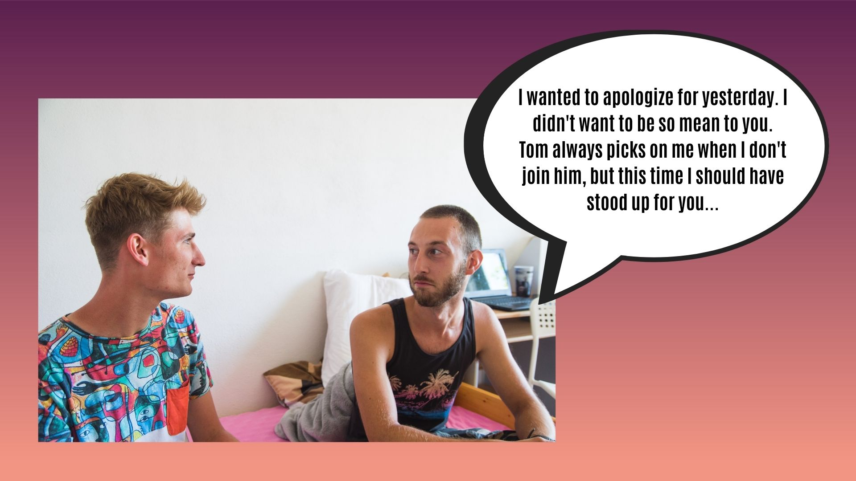

Slide 73
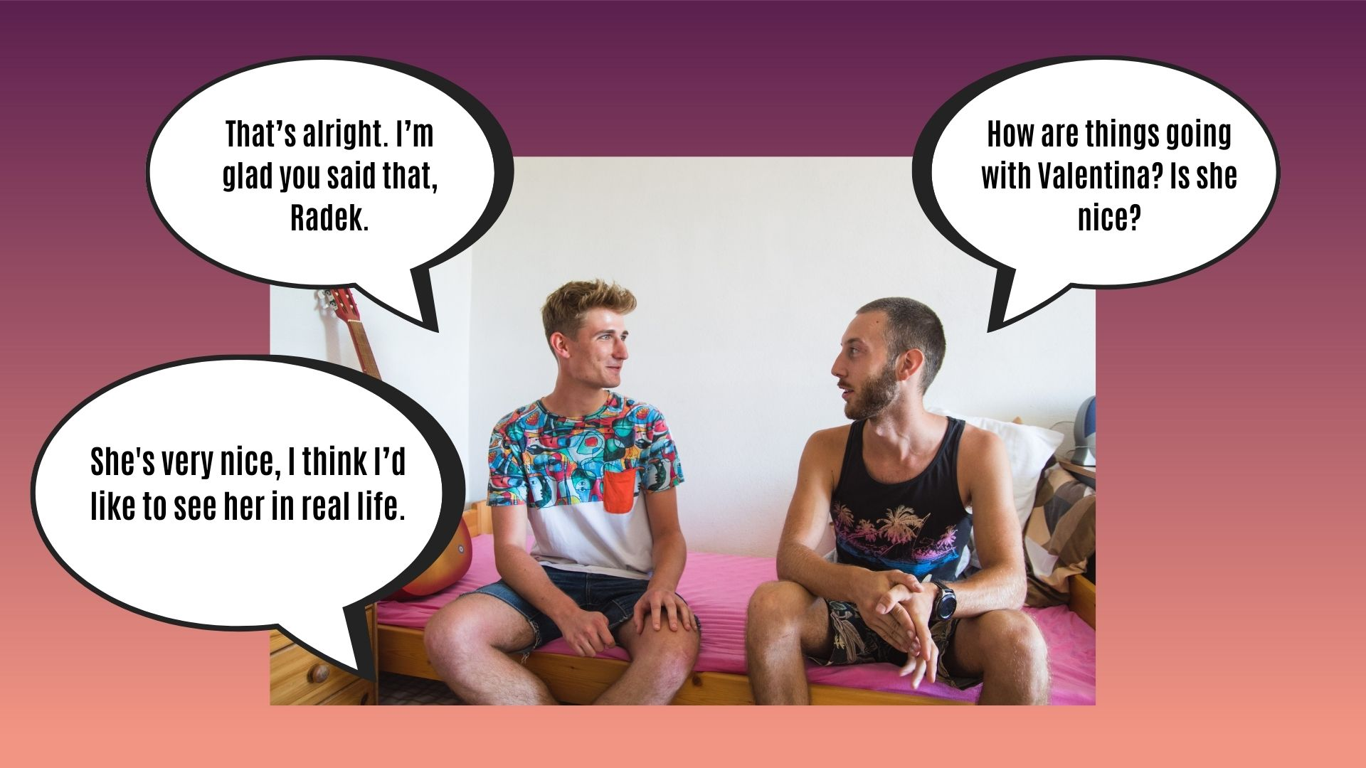

Slide 75
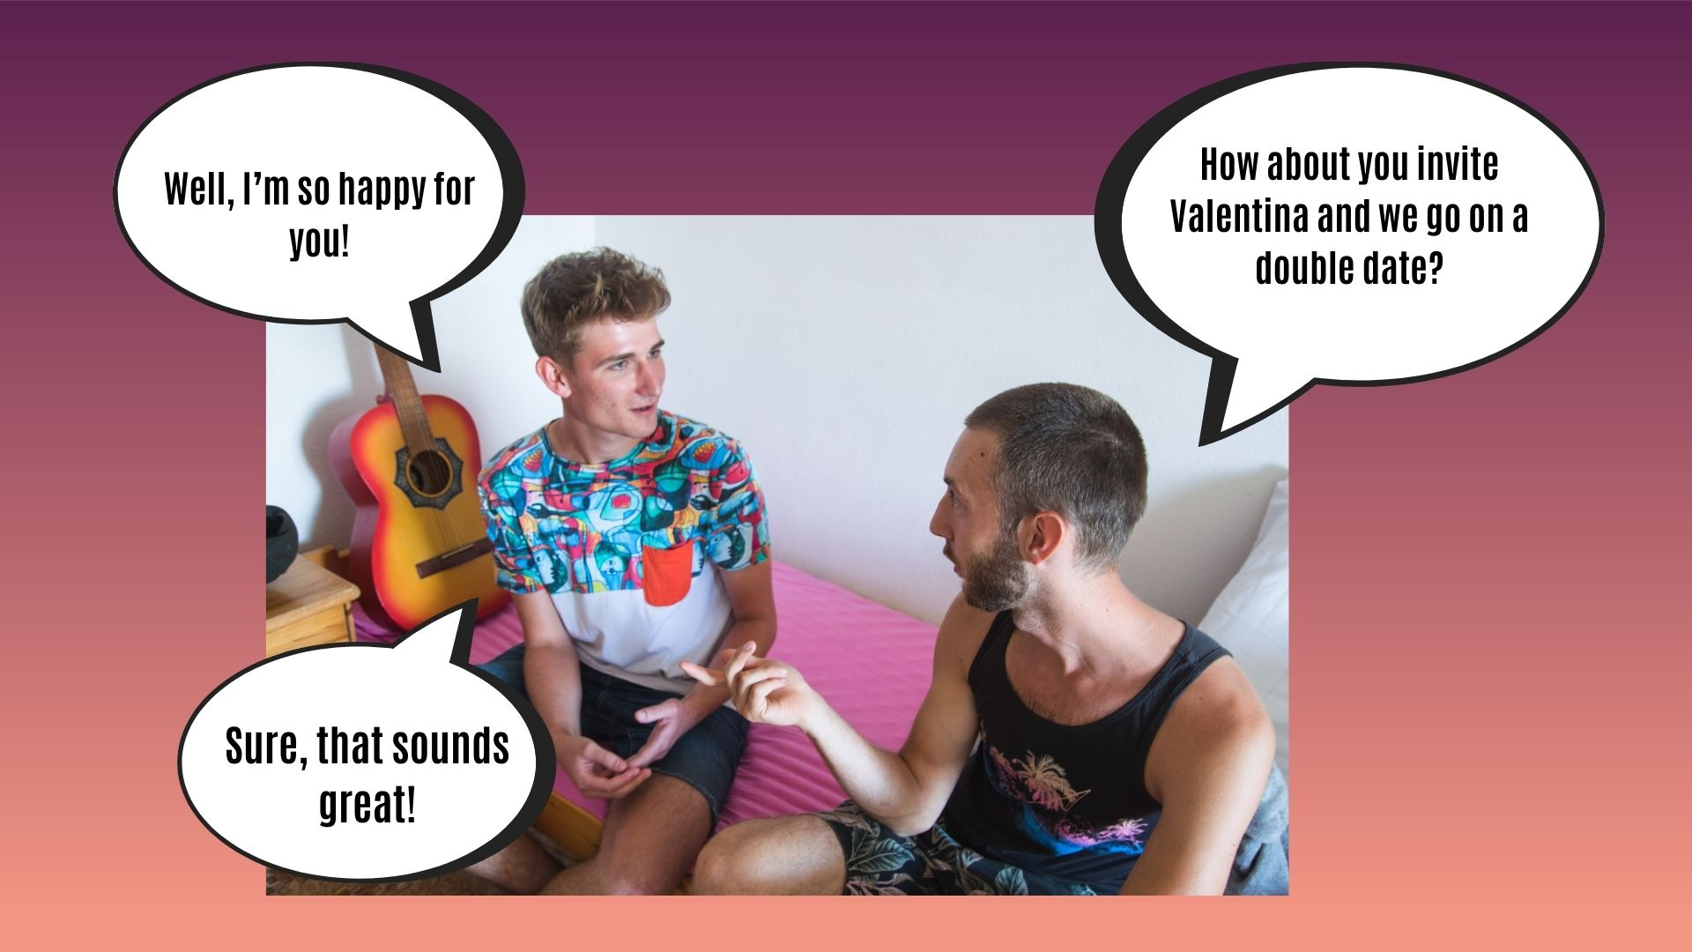

Slide 76
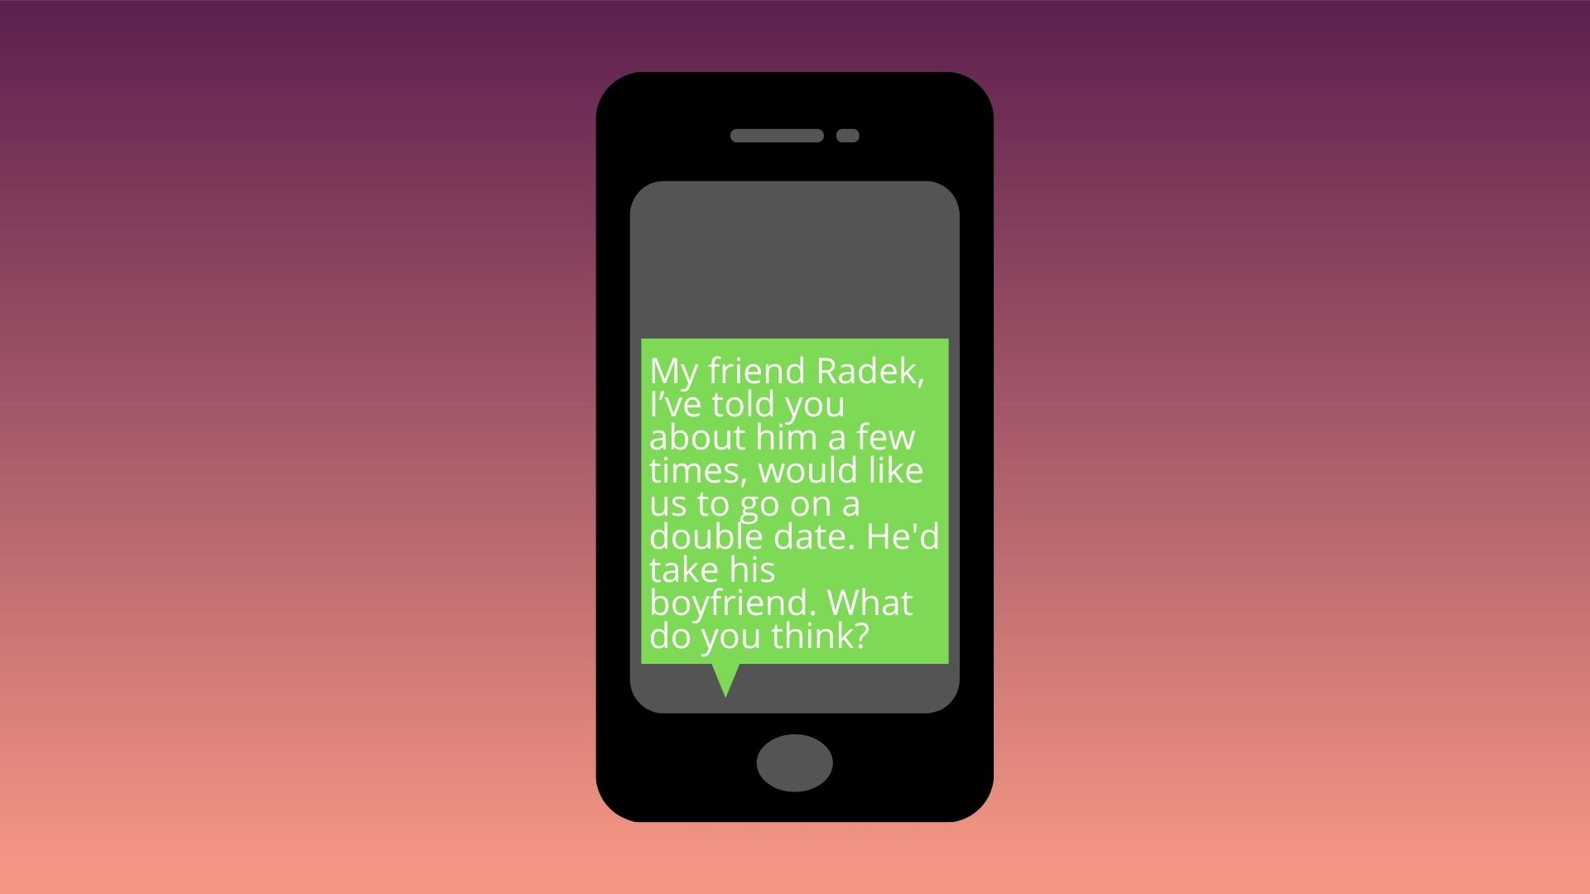

Slide 77
Yeah, I’m in!
No way. What if someone sees me with them?

Slide 82
Well, not really ashamed. I haven't thought this through. Should we try it then?
It bothers me. It’s just weird. I don’t feel like meeting them.

Slide 84
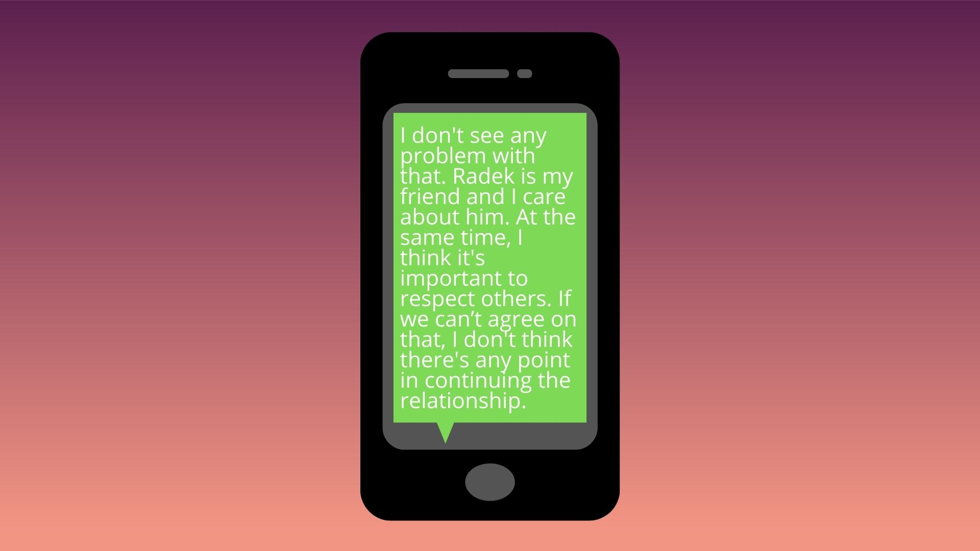

Slide 85
